Slide 1
MAIN
Arduino Connection
Actuation and Measurement
Read Serial
Read Distance
PLC Data send
Write PLC
Write Integer PLC
Write Boolean PLC

Slide 2
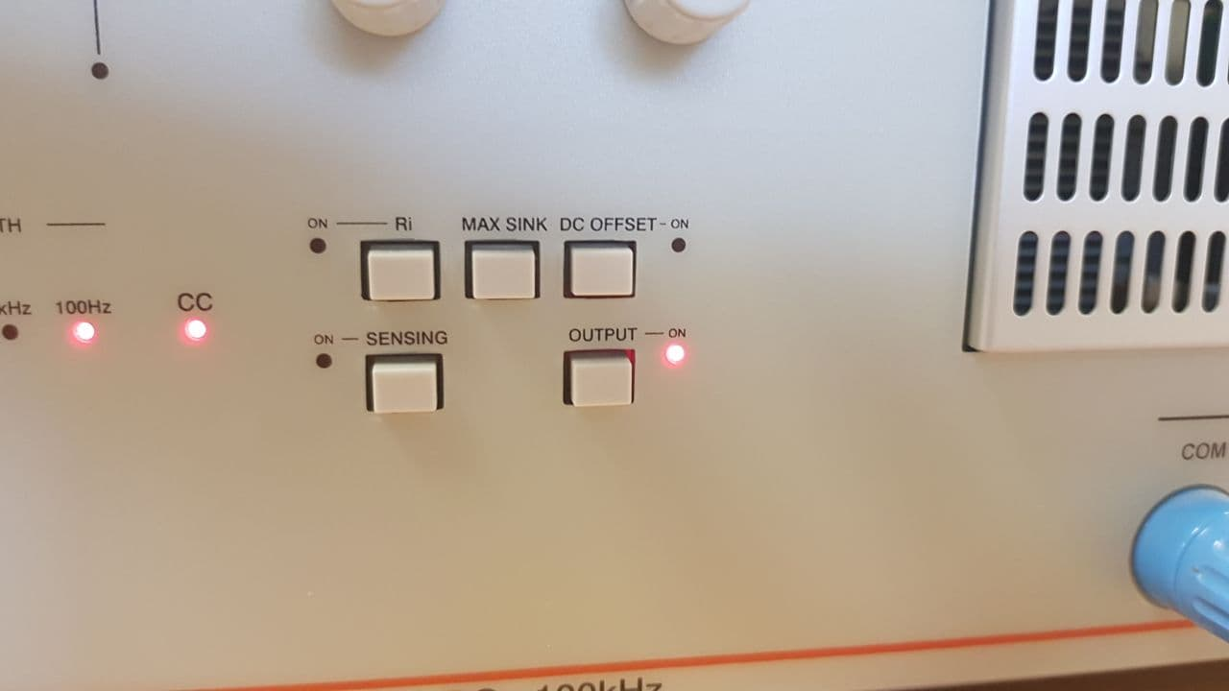
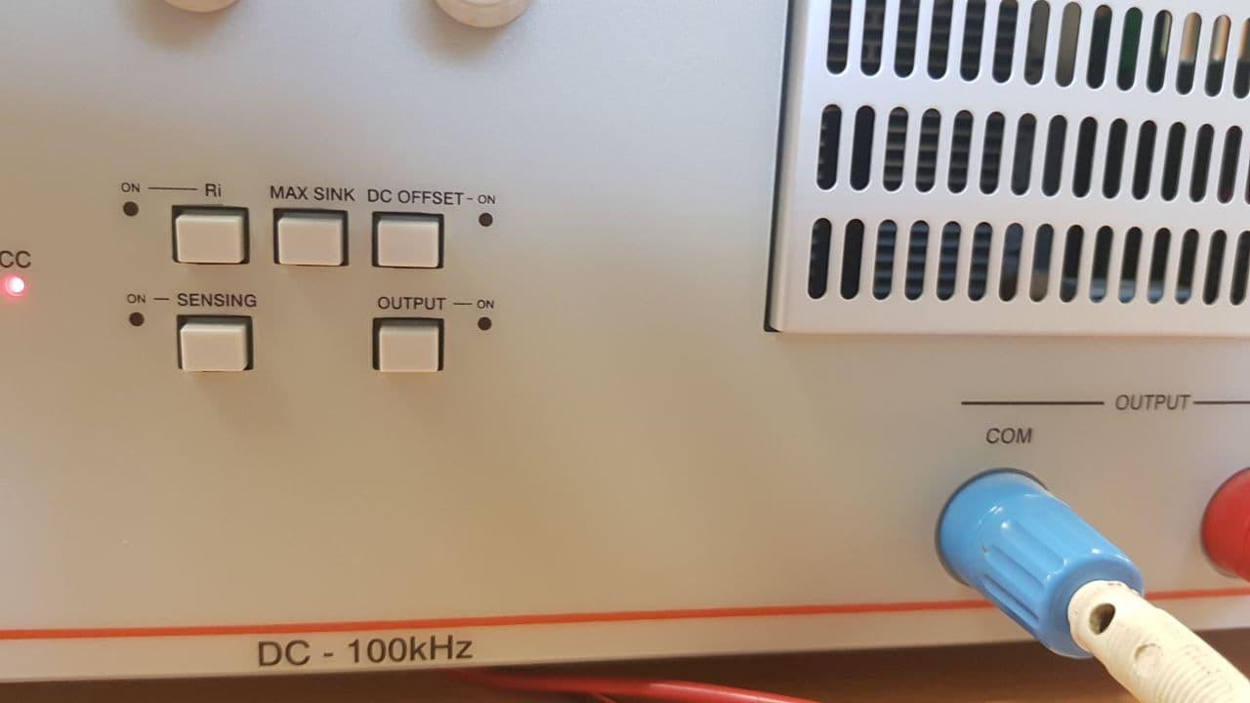

Slide 3
